Slide 1
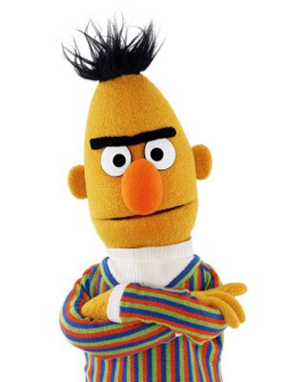
Lab -
BERT and its applications
TA: Tommy, Feiyueh
2024/05/26
Colab

Slide 2
Outline
Lab 1: Encoder Only Model - BERT
Introduction to BERT
Downstream Task Definition
Data Preparation
How to Fine-tune BERT
Coming soon..
Lab 2: Decoder Only Model - GPT2
Lab 3: Encoder-Decoder Model - T5

Slide 3
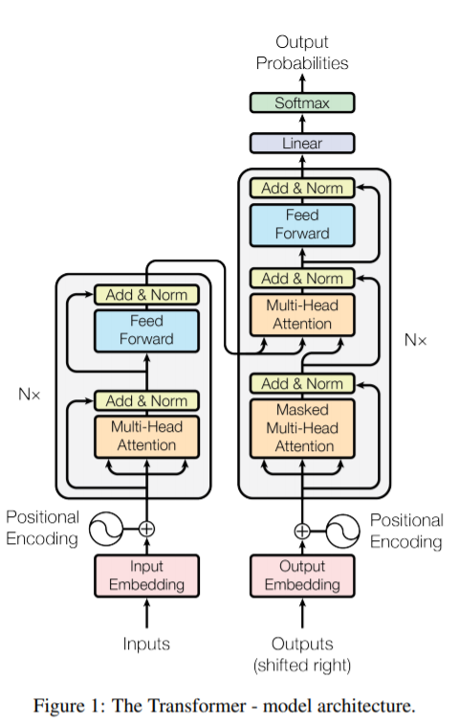
Introduction - What is BERT ?
Encoder
Bidirectional Encoder Representation from Transformers.
i.e., the Encoder part from Transformers, deep and powerful to encode text into contextualized representation.
Pre-trained on large-scale unlabelled corpus to gain this ability.

Slide 4
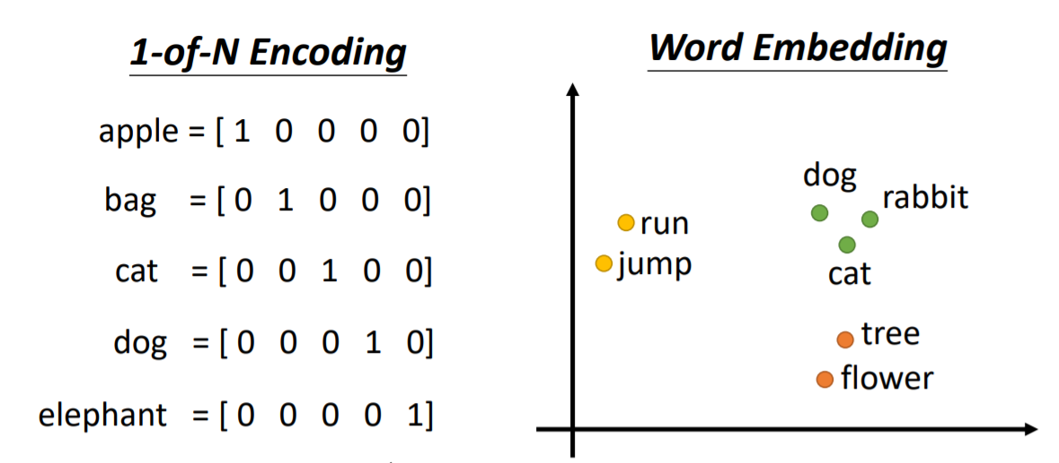
What does “contexualized” mean ?
image source

Slide 5
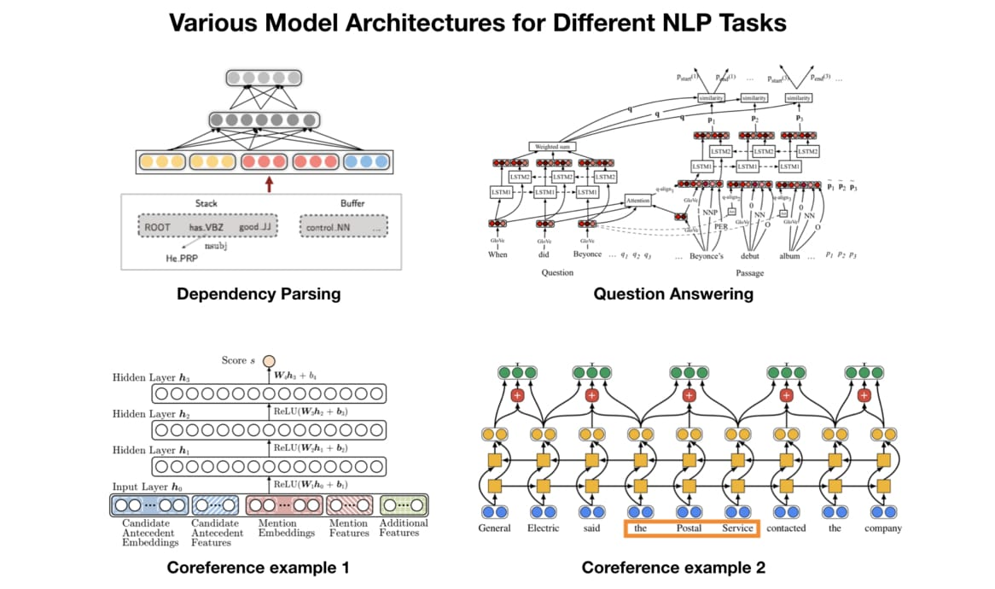
Introduction - Why BERT ?
Conventionally, we have to design different architectures for different tasks.

Slide 6
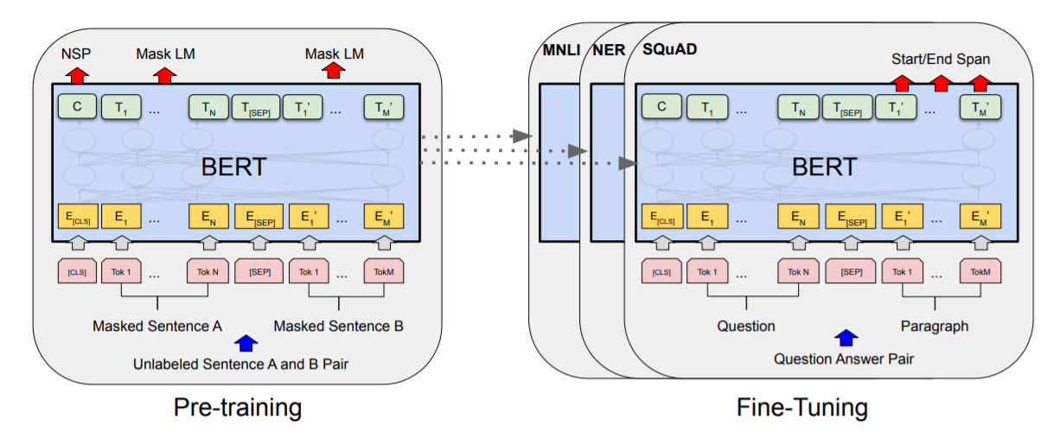
What if we have a general language model ?

Slide 7
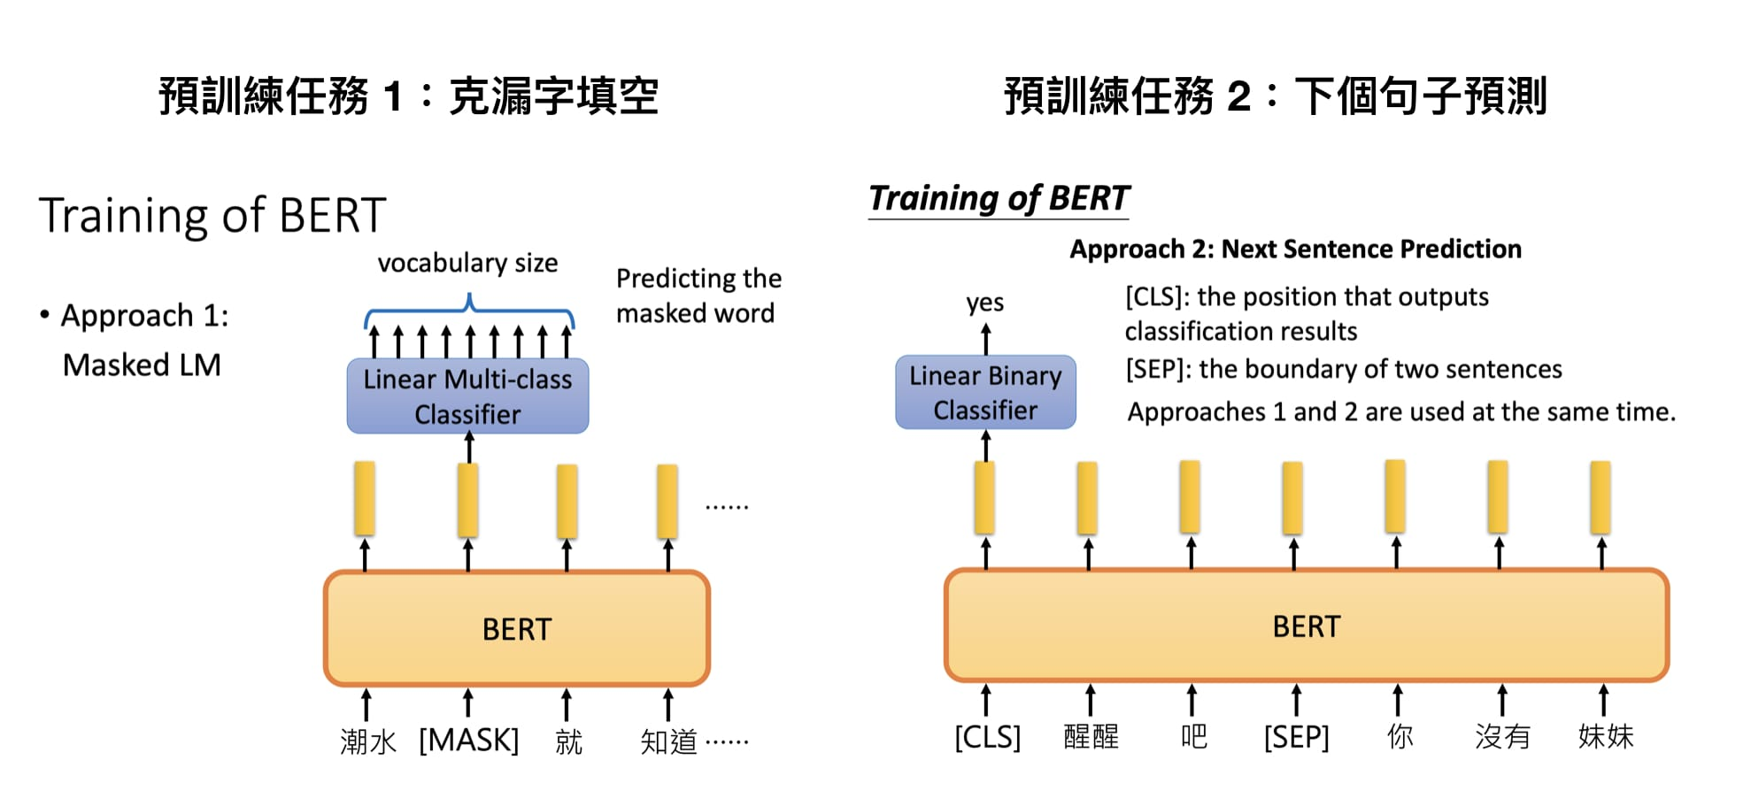
How BERT is pre-trained
How to exploit large-scale unlabelled corpus spread in the web?
(1) Randomly masking words, and ask model to predict it.
(2) Next sentence prediction.
image source

Slide 8

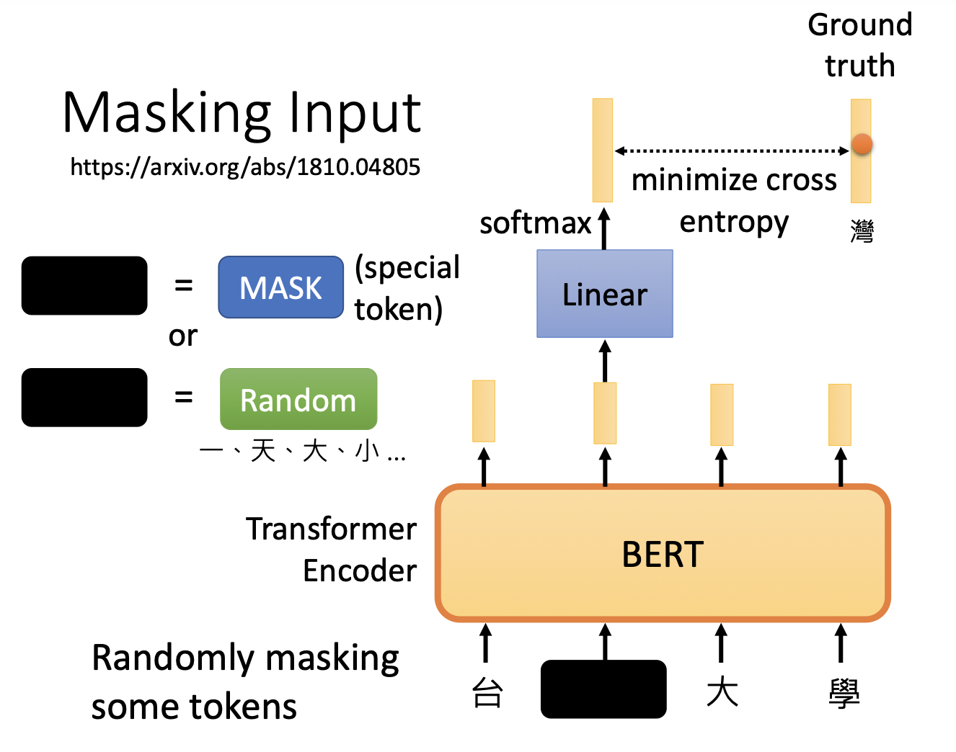
Masked Language Model
Randomly mask 15% of tokens.
Weak classifier is used to predict the appropriate word given context.
Words that fit in the same context will have similar embeddings.
image source

Slide 9
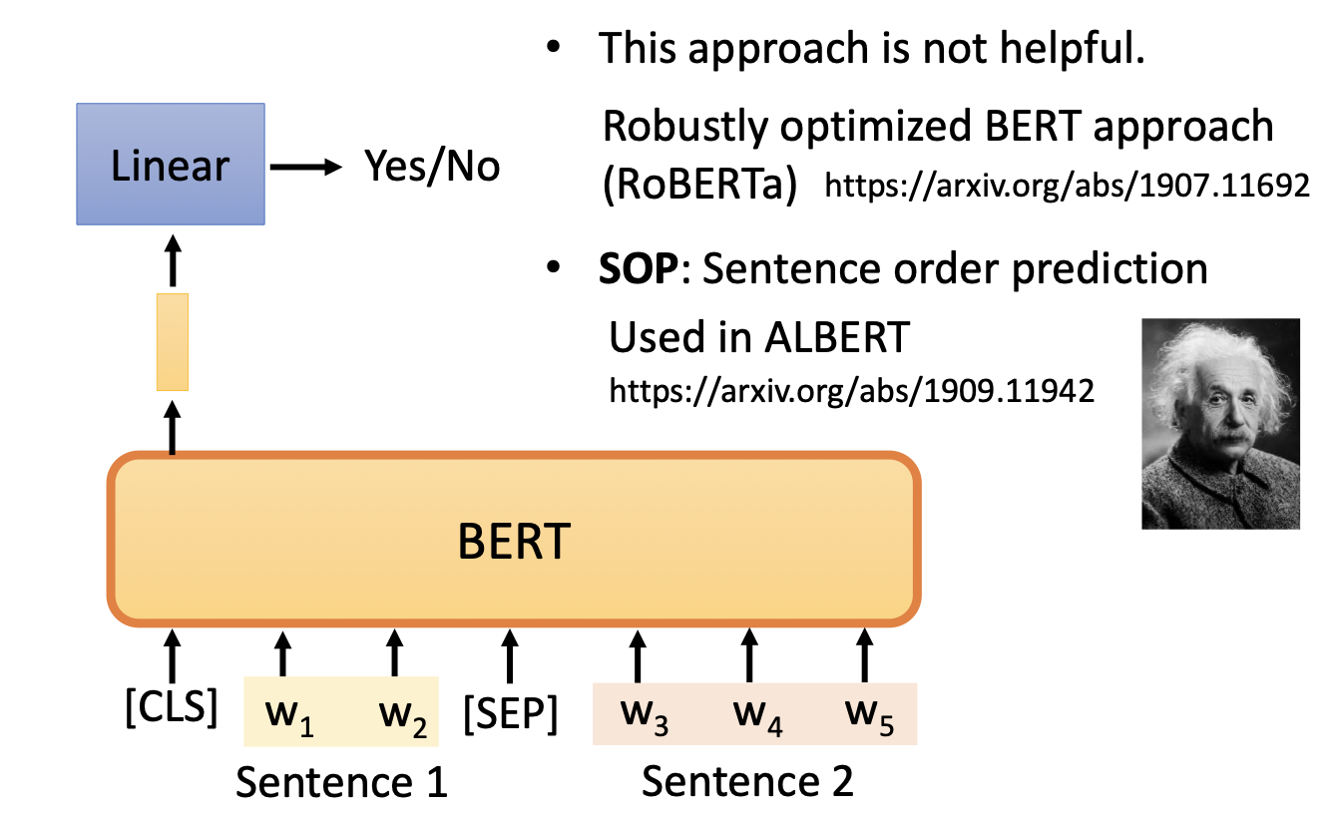
Next Sentence Prediction
[CLS]: special token indicating the position to connect classifier.
[SEP]: special token indicating the boundary of the two sentences.
Two tasks are jointly trained.
12 encoder layers with 110M parameters
image source

Slide 10
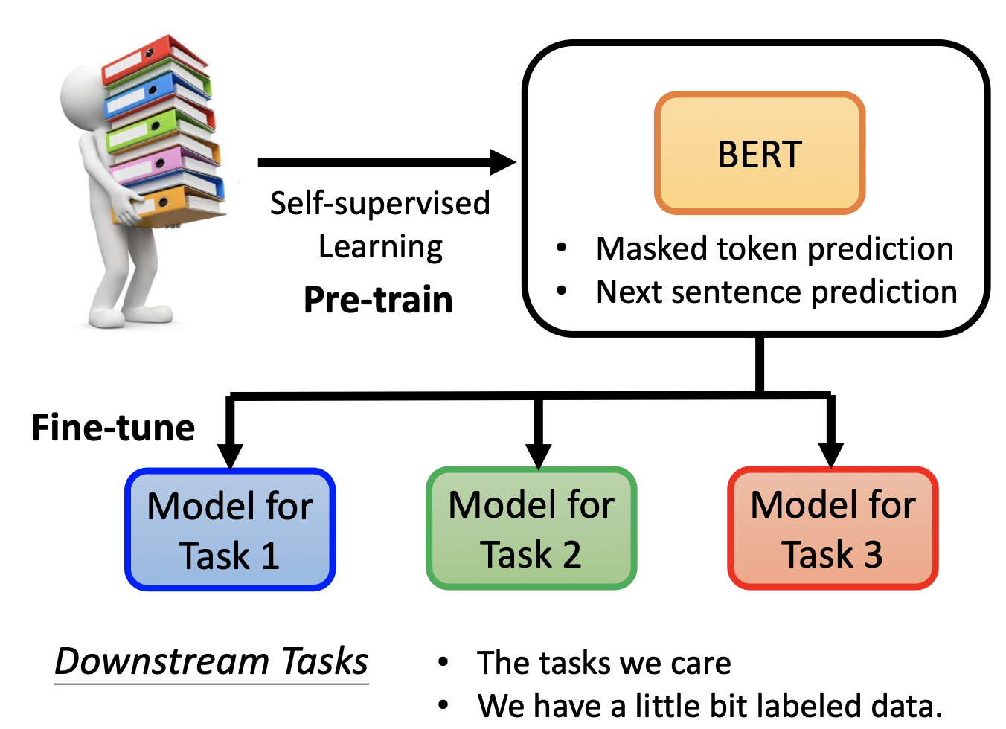

Slide 11
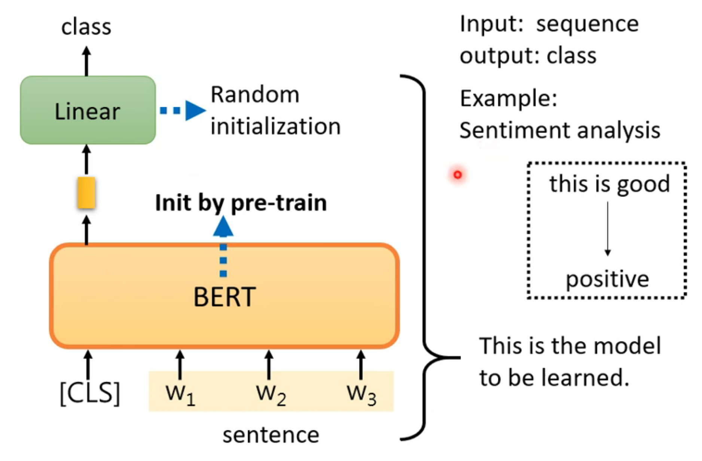
How to use BERT - Case 1
image source

Slide 12
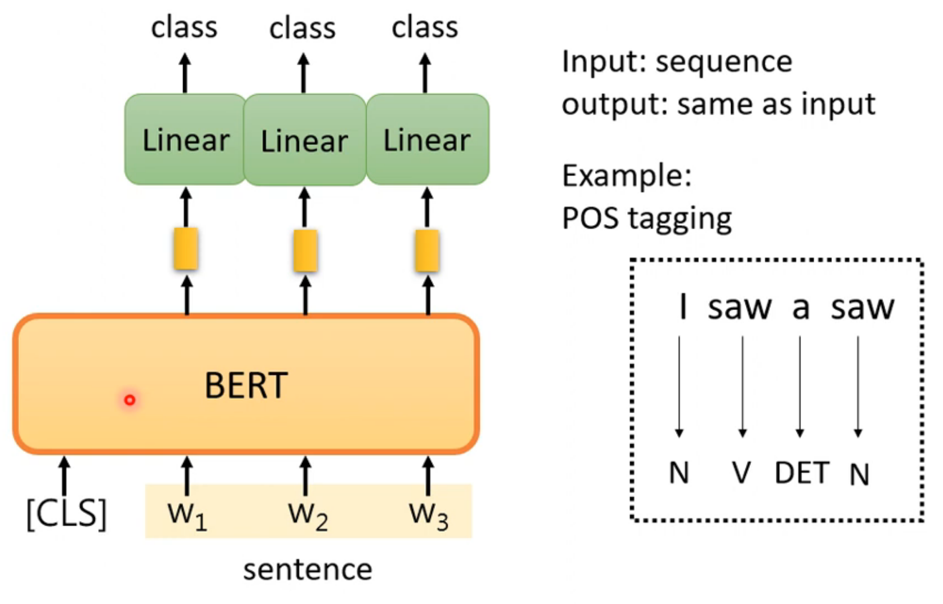
How to use BERT - Case 2
image source

Slide 13
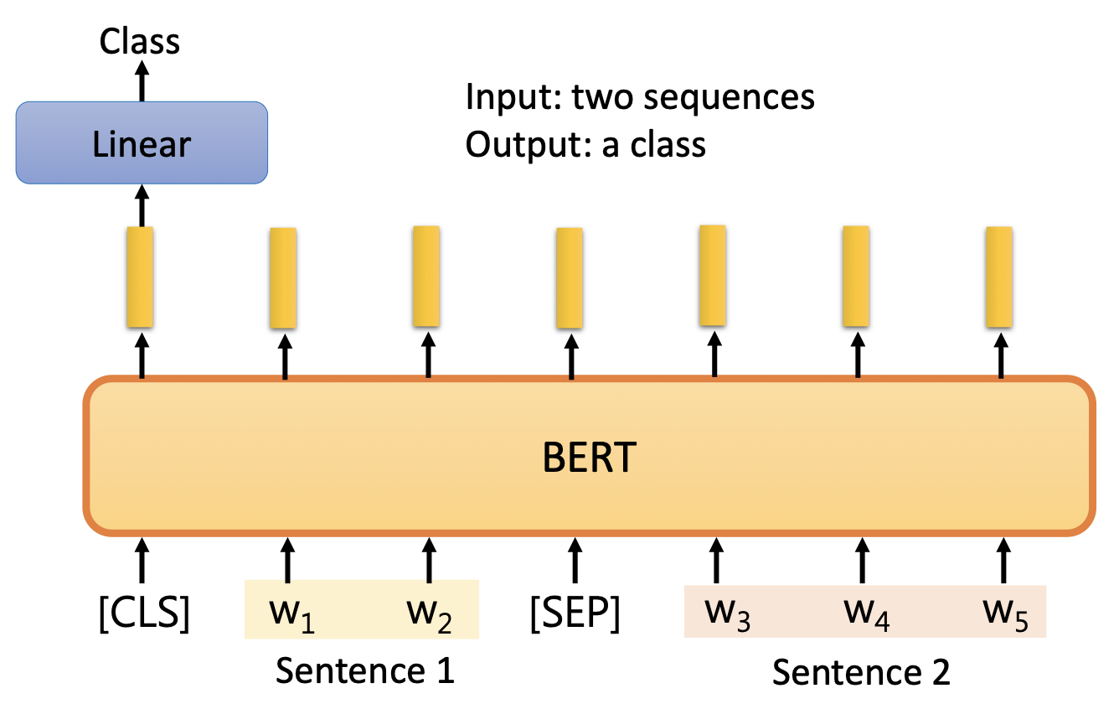
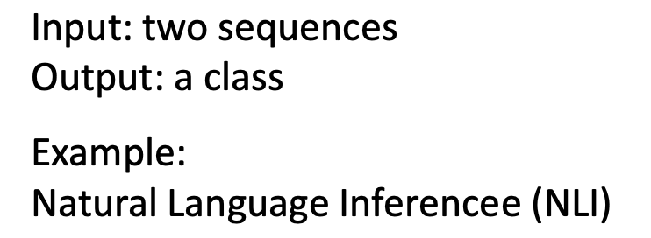
How to use BERT - Case 3
image source

Slide 14
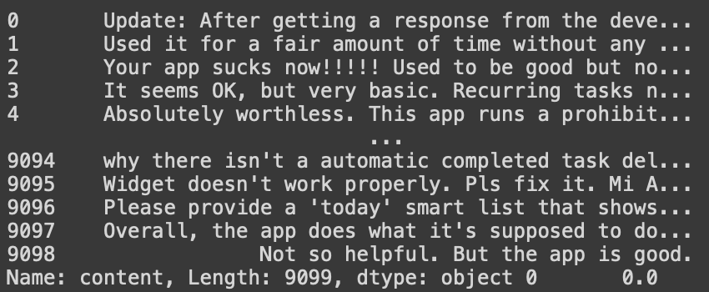
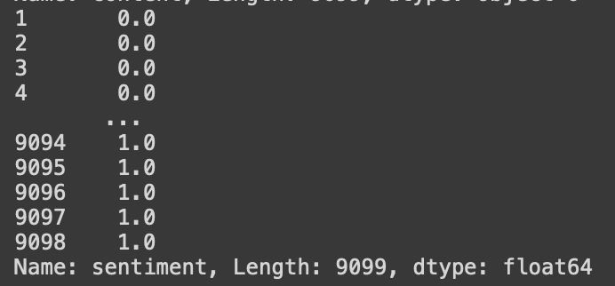
Sentiment Classification Task
Given a review (content),
determine the sentiment of this review: negative(0) / neutral(1) / positive(2)

Slide 15

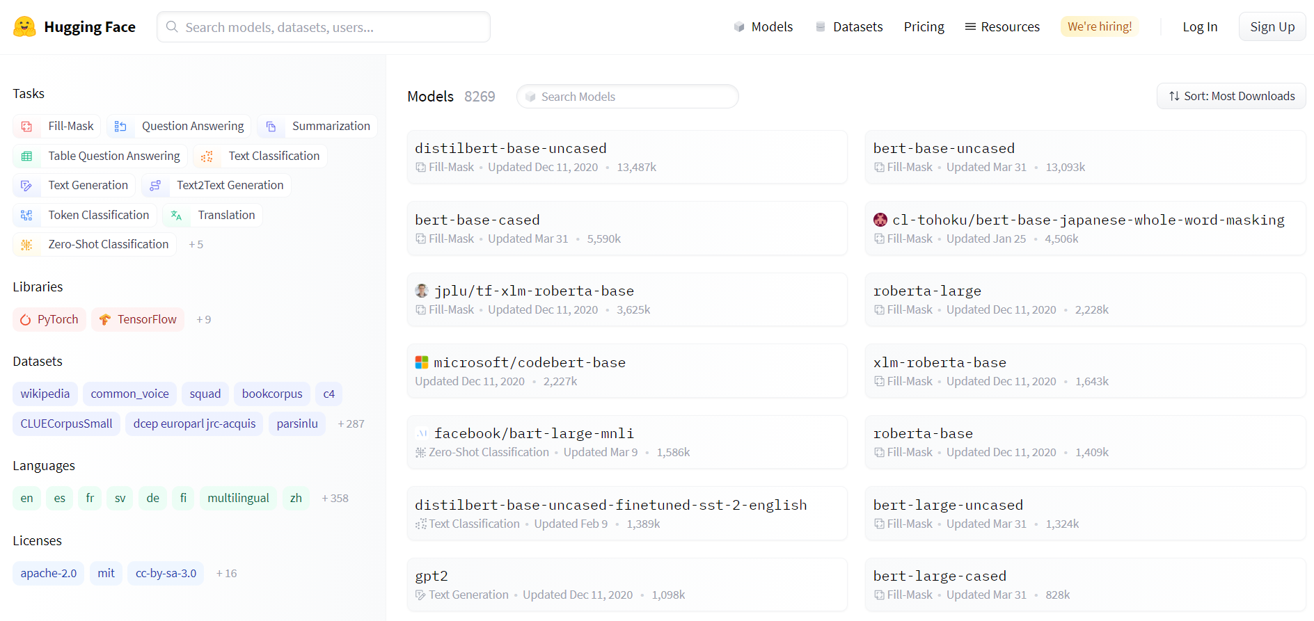
Good News! We have
Implemented up to 55 kinds of variation of BERT, more than 300 languages,
with different size of pre-trained weights available !
Github Link

Slide 16
How do we fine-tune BERT for downstream task ?
Prepare raw dataset.
Transform the original data to BERT-required format.
(Optional) adding more layers.
Load the weights of pre-trained BERT model.
Fine-tune BERT by training on downstream task data.
Make inference on testing data.

Slide 17
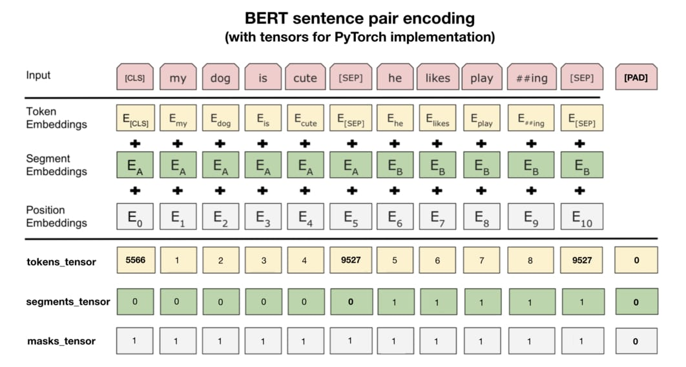
Data format for BERT

Slide 18
Data format for BERT
Almost the most important thing when fine-tuning BERT.
token tensor: token id correspond to each token, convert by BertTokenizer.
segment_tensor: indicate the token belongs to the first sentence or the second.
mask_tensor: indicate position of valid token, where the model need to attend.

Slide 19
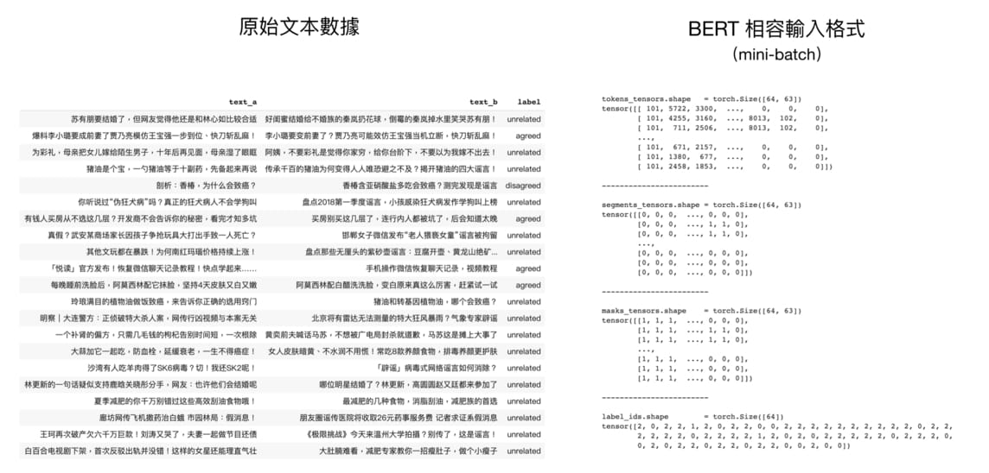
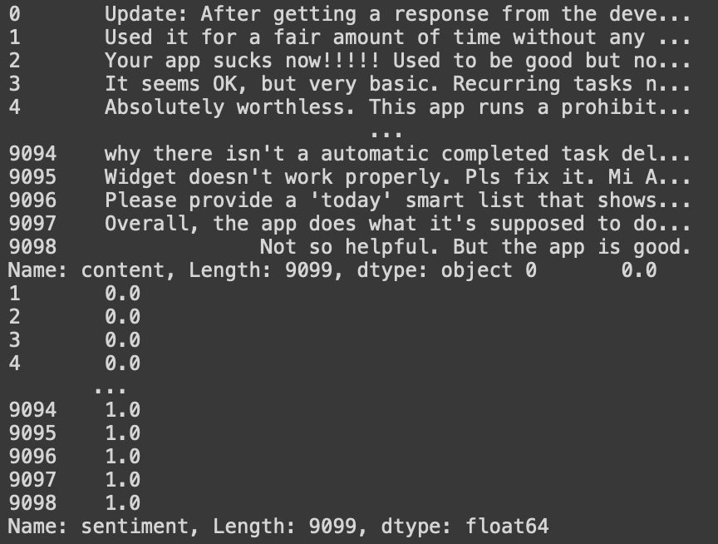
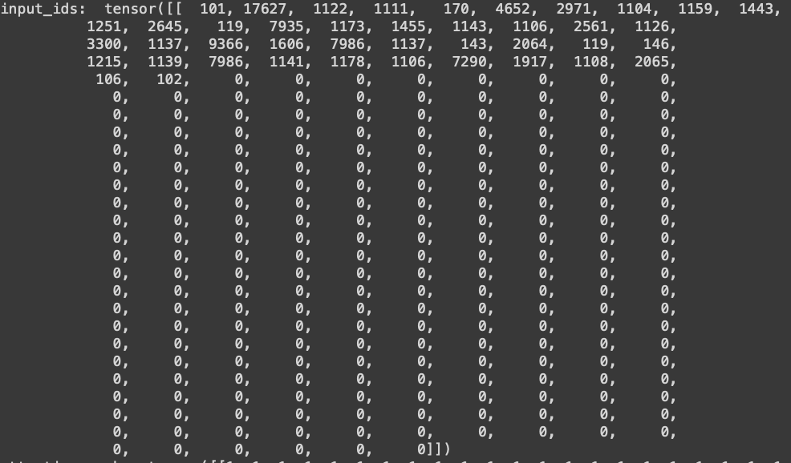
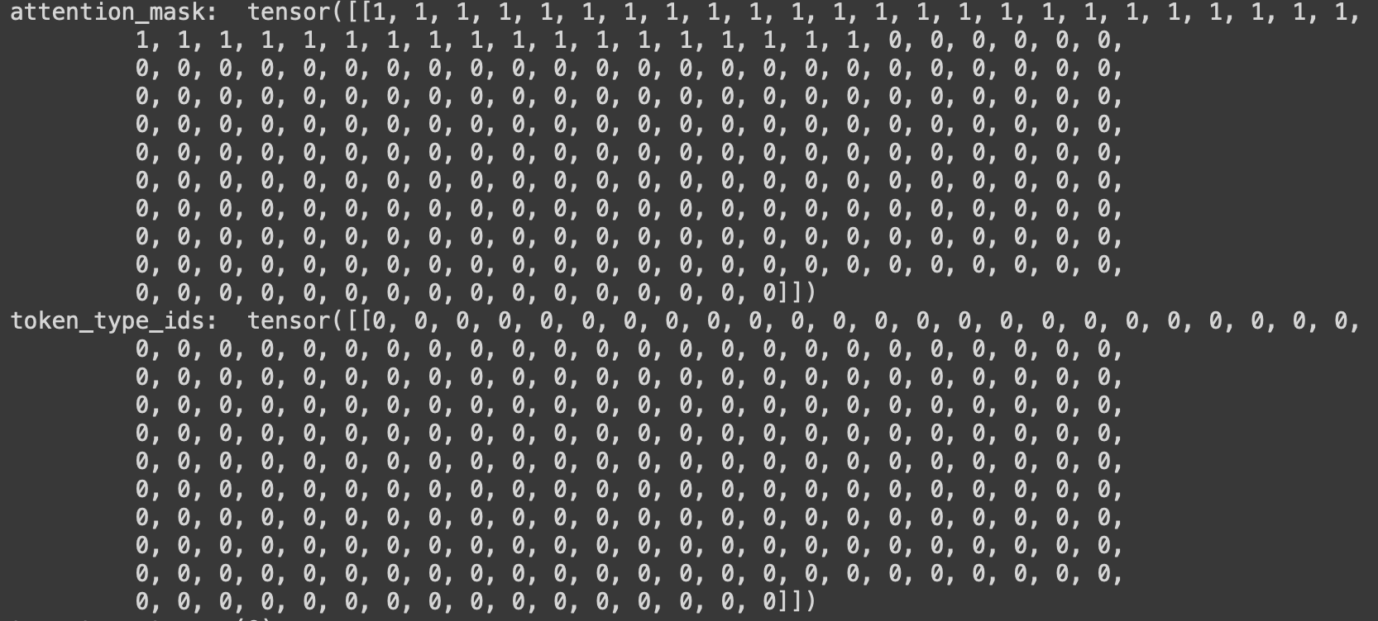
Data format for BERT

Slide 20
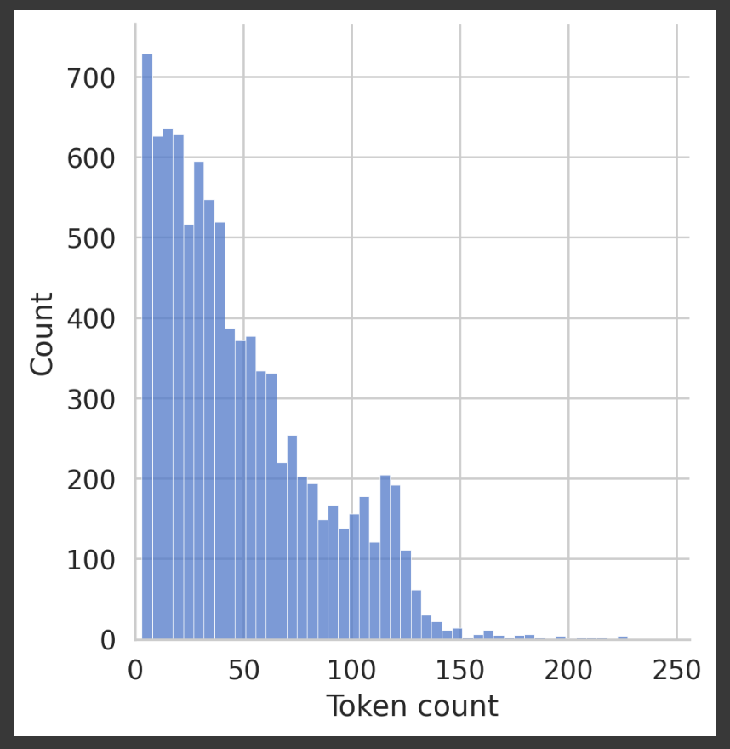
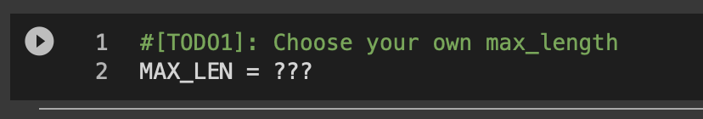
TODO1: Choose a proper max_length for tokenization

Slide 21
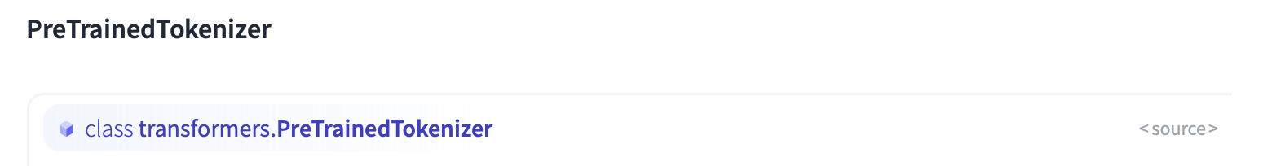
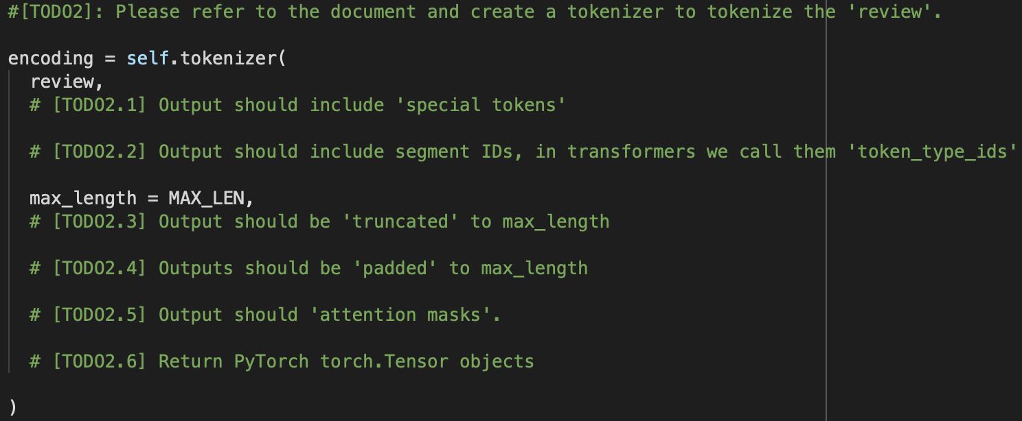
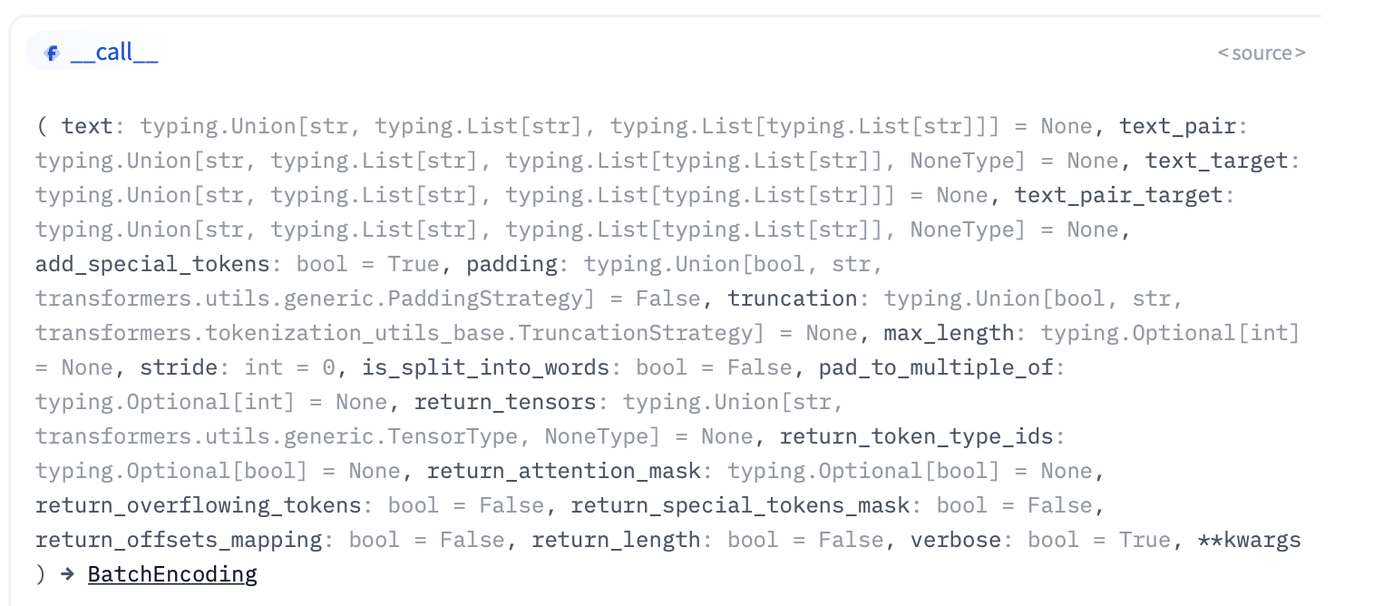
TODO2: Create a customized Tokenizer!
source

Slide 22
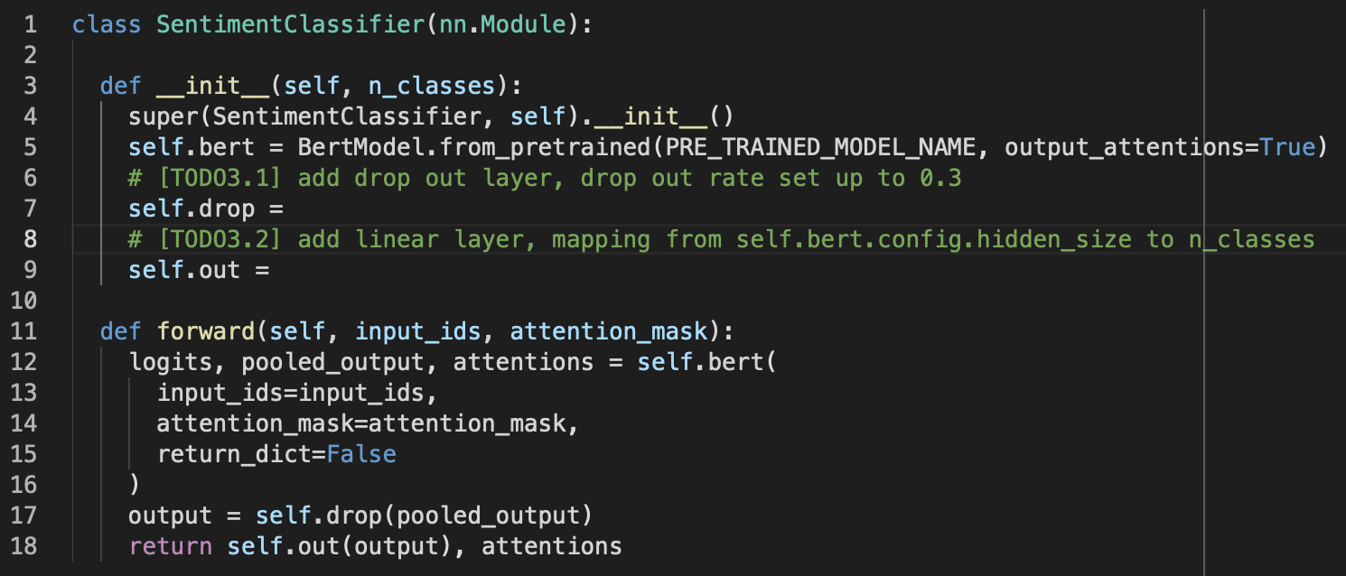
TODO3: Create a our sentimentClassifier with BERT
reference

Slide 23
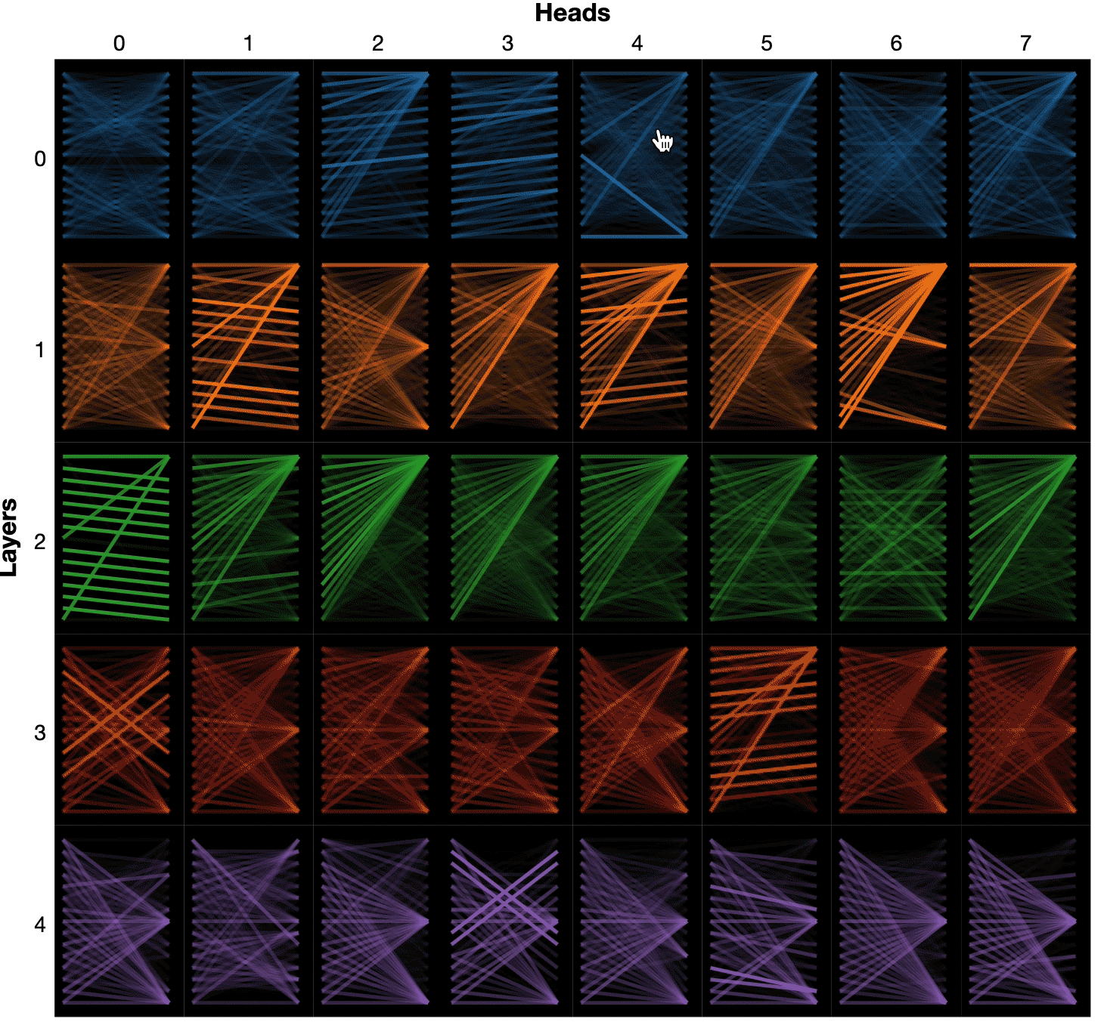
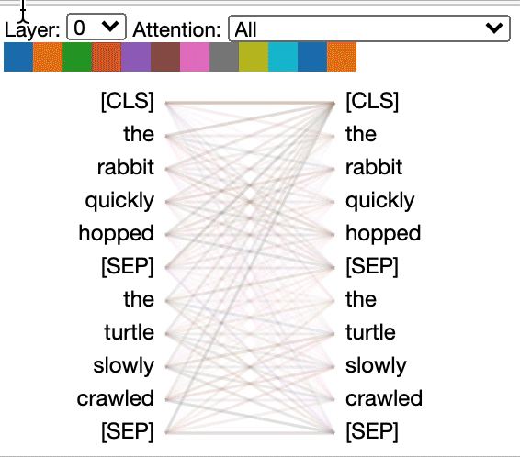
TODO3: Look into BERT with bertviz

Slide 24
Let’s get started !

Slide 25
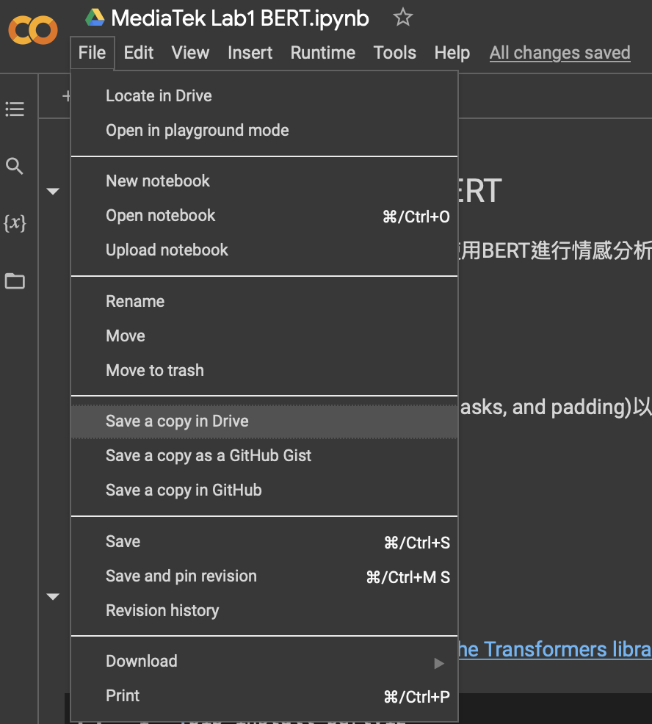
Files will be stored in your Google drive.
Store TA’s file to your Google drive.
System shortcuts
! ls
! cd <path>
! pip install <package>

Slide 26
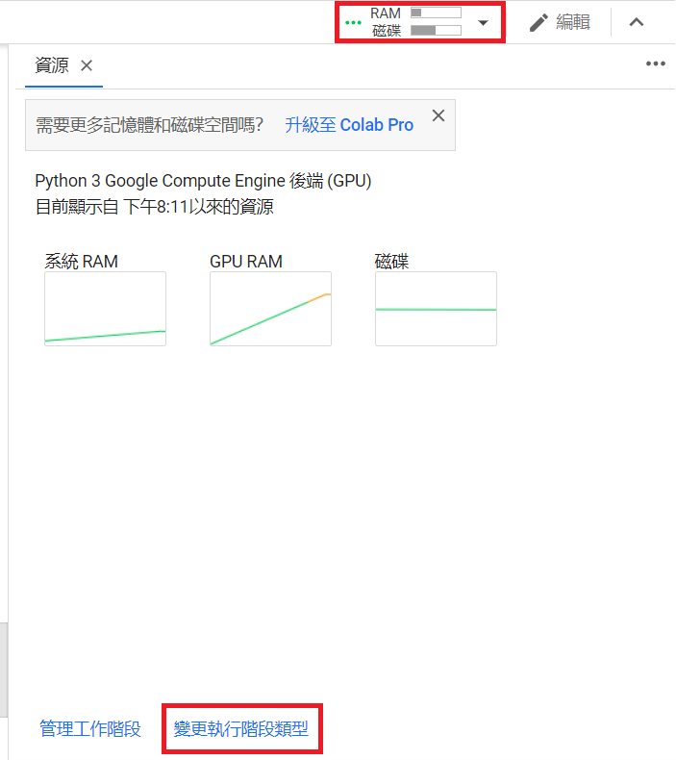
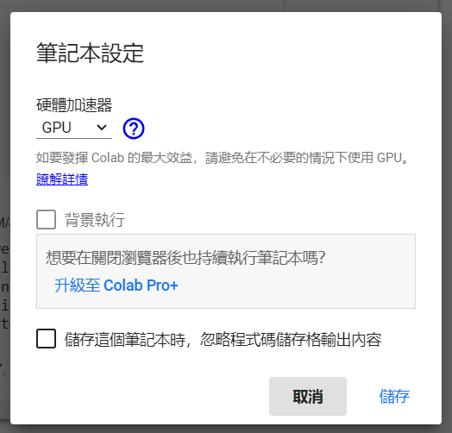
Use GPU on Google Colab to accelerate training

Slide 27
Feel free to ask TAs questions if you encounter problems!
Slido

